Slide 1

Darwinian Life

Slide 2
The Biointelligence Explosion
David Pearce
How recursively self-improving organic robots will modify their own source code and bootstrap our way to superintelligence
“Homo sapiens, the first truly free species, is about to decommission natural selection, the force that made us.... Soon we must look deep within ourselves and decide what we wish to become.”
-Edward O. Wilson
Consilience, The Unity of Knowledge (1999)
“I predict that the domestication of biotechnology will dominate our lives during the next fifty years at least as much as the domestication of computers has dominated our lives during the previous fifty years.”
-Freeman Dyson

Slide 3
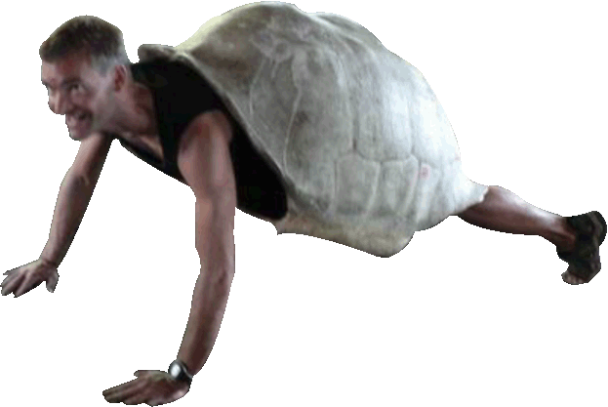
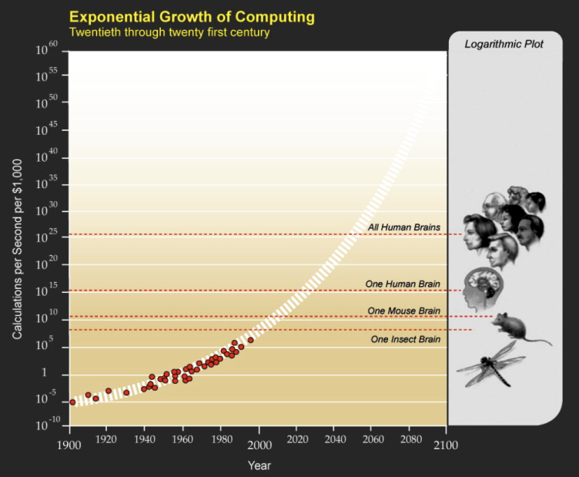
The Fate of the Germline
Biological Humanity versus Digital Computers
Computers and AI
Will biological evolution be replaced by technological evolution?
Ray Kurzweil's “Law of Accelerating Returns”:
Whereas human genetic evolution is slow, software run on serial, programmable digital computers can be executed ever faster (cf. Moore's law); it's copyable without limit; it runs on multiple substrates; it can be rapidly edited, tested and debugged.
Will human programmers become redundant as AI run on digital computers undergoes accelerating cycles of self-improvement?
Will AI lead to recursively self-improving, greater-than-human intelligence followed rapidly by artificial superintelligence?
Will biological evolution be replaced by technological evolution?

Slide 4
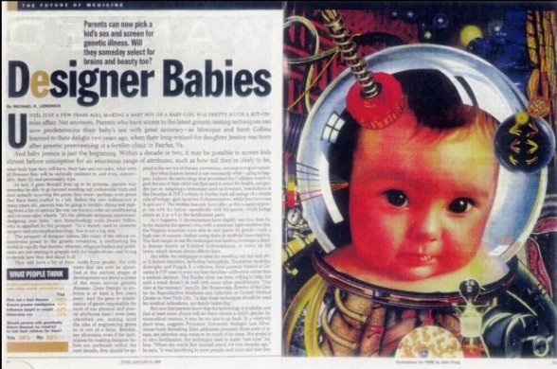

The Reproductive Revolution
Preimplantation Genetic Diagnosis
The Fate of the Germline
“Designer Babies”: prospective parents will soon pre-select alleles and allelic combinations for a new child in anticipation of their behavioural effects - a novel kind of selection pressure to replace the “blind” genetic roulette of natural selection.
Germline therapy will be followed by cognitive and affective enhancement.
BUT
Germline engineering will still be a comparatively slow process unfolding over hundreds and thousands of years.
www.reproductive-revolution.com

Slide 5
Somatic gene enhancement
Biohacking Your Personal Genome
Biohacking: Starting with individual genes, then clusters of genes, and eventually hundreds of genes and alternative splice variants, a host of recursively self-improving organic robots (“biohackers”) are destined to modify their own source code and modes of sentience: their senses, their perceptual apparatus, their moods, their motivation, their world-simulations, their cognitive apparatus and their default state of consciousness
Friendly Software: For the open-source genetic revolution will be propelled by powerful suites of high-level gene editing tools, insertion vector applications, nonviral gene-editing kits, and user-friendly interfaces. Clever computer modelling and "narrow" AI can assist the biohacker. Later this century, your smarter counterpart will be able to monitor and edit every gene, repressor, promoter and splice variant in every part of your genome, each layer of epigenetic regulation of your gene transcription machinery.
Symbiosis: (trans)humans will exploit "narrow" or "weak" AI to enhance our own code in a positive feedback loop of mutual enhancement

Slide 6


RISKS
What is our greatest underlying source of global catastrophic risk and existential risk?
Non-friendly AI?
or
The competitive dominance behaviour
of alpha male primates?
Can We Build Friendly Biological SuperIntelligence?
MDMA analogues?
Mass oxytocination?
Mirror-Touch Synaesthesia?
Does Full-Spectrum Superintelligence Entail Benevolence?
Perspective-taking, "mind-reading", Full-Spectrum Superintelligence understands your thoughts and feelings better than you do yourself. BUT
Do we have time?

Slide 7
What Is Full-Spectrum Superintelligence? (1)
“[g is] ostensibly some innate scalar brain force.... ....[However] ability is a folk concept and not amenable to scientific analysis.”
-Jon Marks
Dept Anthropology, (Yale University), 1995, Nature, 9 xi, 143-144.
“Our normal waking consciousness, rational consciousness as we call it, is but one special type of consciousness, whilst all about it, parted from it by the filmiest of screens, there lie potential forms of consciousness entirely different.”
-William James

Slide 8
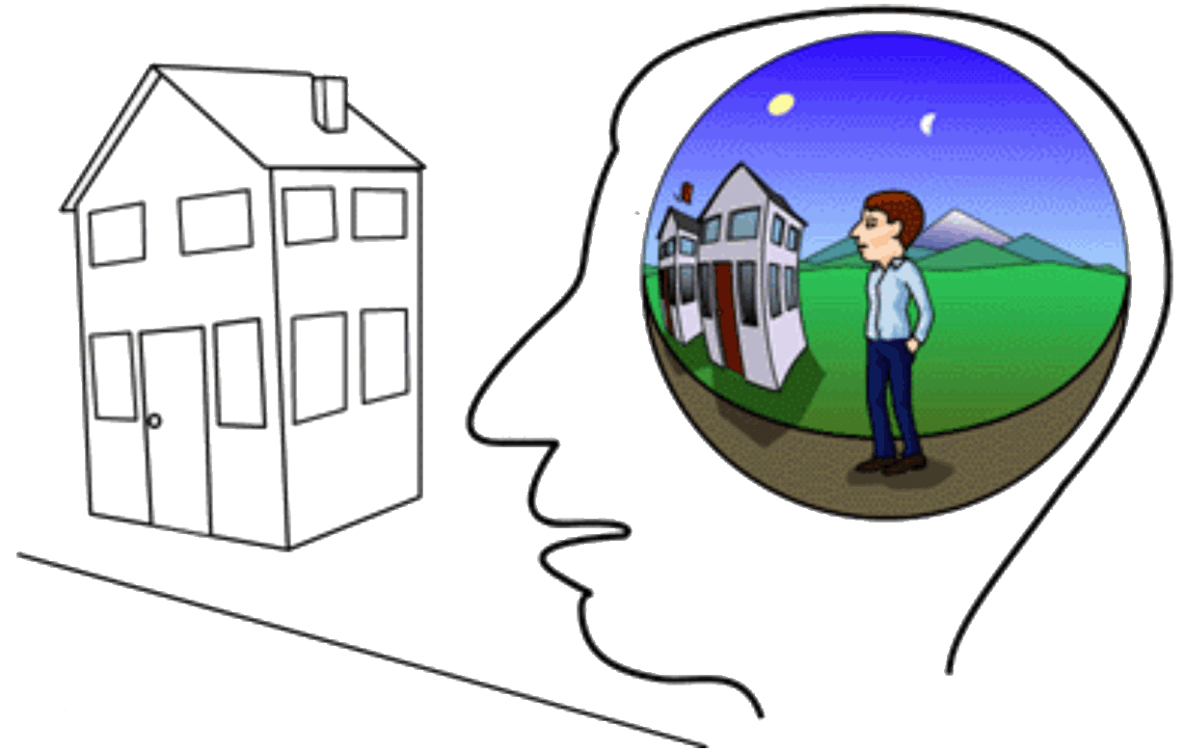
What Is Full-Spectrum Superintelligence? (1)
Full-Spectrum Superintelligence entails:
1) the capacity to solve the binding problem and run real-time, cross-modal, data-driven world-simulations of the mind-independent environment.(cf. naive realist theories of "perception" versus the world-simulation paradigm; disorders of binding: simultanagnosia (inability to perceive the visual field as a whole), cerebral akinetopsia (“motion blindness”), etc) In the absence of a data-driven simulation of the environment, intelligent agency is impossible.
Ref: Consciousness and Cognition 8, 173–185 (1999)
Binding and the Phenomenal Unity of Consciousness
Antti Revonsuo

Slide 9

What Is Full-Spectrum Superintelligence? (1)

Slide 10
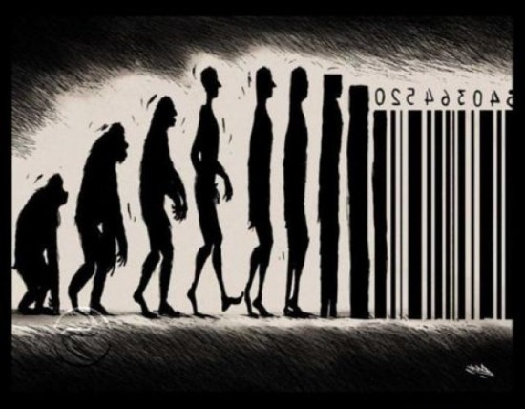
What Is Full-Spectrum Superintelligence? (1)
Whole Brain Emulation??
BUT
Can a serial digital computer solve the binding problem?

Slide 11
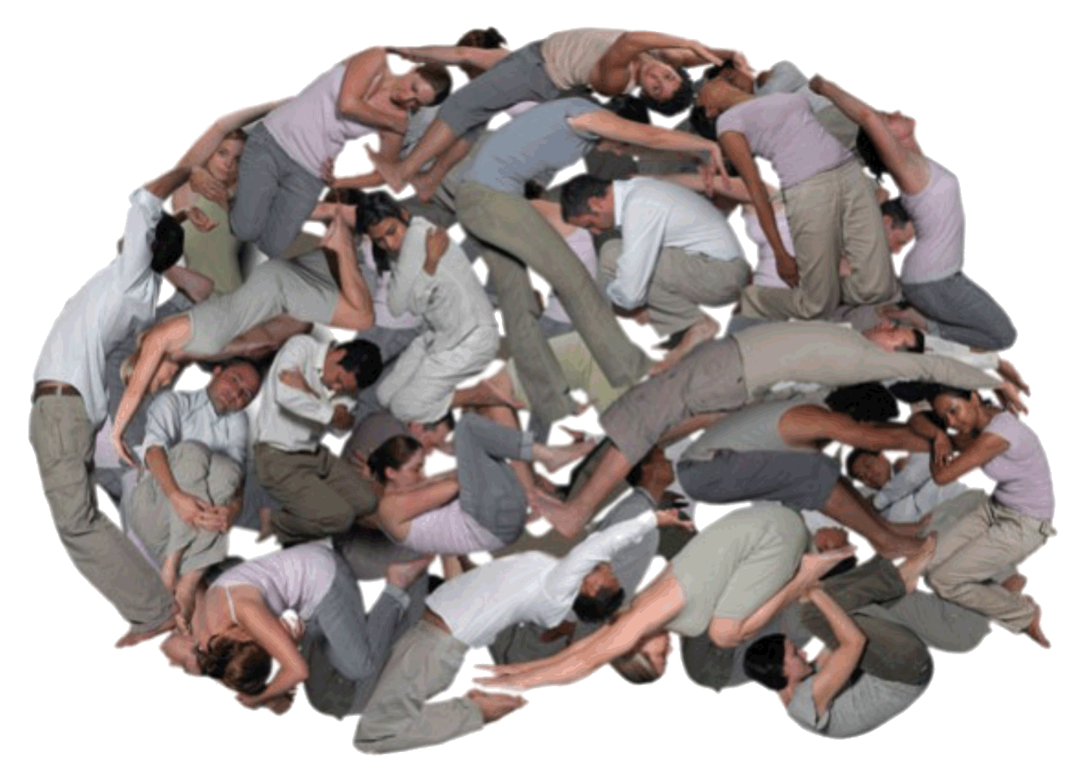
What Is Full-Spectrum Superintelligence? (2)
2) a self or some non-arbitrary functional equivalent of a person to which intelligence can be ascribed.
(cf. dissociative identity disorder (DID), or florid schizophrenia, or your PC. In the absence of at least a fleetingly unitary self, there is no entity that is intelligent, just an aggregate of smart algorithms and an operating system.)

Slide 12
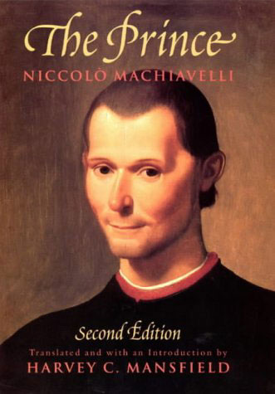
What Is Full-Spectrum Superintelligence? (3)
3) a “mind-reading”, perspective-taking capacity; higher-order intentionality: social cognition. The intellectual success of the most cognitively successful species on the planet rests not just on our recursive syntax but also on our unsurpassed “mind-reading” prowess: the “Machiavellian Ape” hypothesis. Any ecologically valid intelligence test designed for a species of social animal must incorporate social cognition.

Slide 13
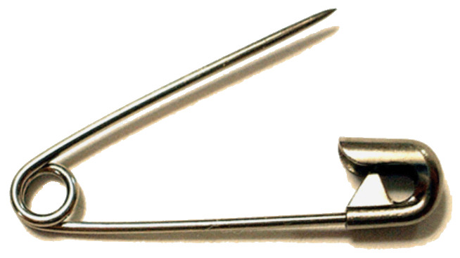

What Is Full-Spectrum Superintelligence? (4)
4) a metric to distinguish the important from the trivial.
(our theory of significance should be explicit rather than implicit as in contemporary IQ tests. What distinguishes, say, calendrical prodigies and other “savant syndromes” from, say, a Grigori Perelman who proved the Poincaré conjecture?)

Slide 14

What Is Full-Spectrum Superintelligence? (5)
5) a capacity to navigate multiple state-spaces of consciousness [e.g. dreaming states (cf. lucid dreaming), waking consciousness, echolocatory prowess, visual prowess, introspection, the different realms of psychedelia (cf. salvia space, “the K-hole” etc)] including realms of experience not yet co-opted by either natural selection or posthuman design for tracking features of the mind-independent world.

Slide 15
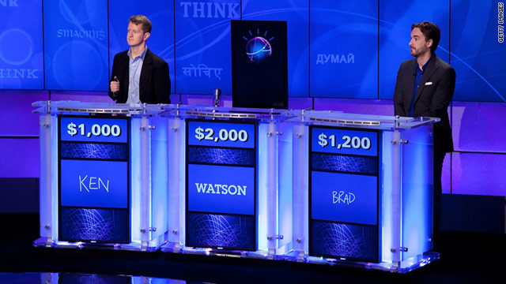
What Is Full-Spectrum Superintelligence? (6)
6) “Autistic”, pattern-matching, rule-following, mathematico-linguistic intelligence: the standard, mind-blind cognitive tool-kit scored by existing IQ tests.
Ref: www.wired.com/wired/archive/9.12/aqtest.html

Slide 16
What Is Full-Spectrum Superintelligence? (6)
IQ Tests
High-functioning “autistic” intelligence is indispenable to higher mathematics, computer science and the natural sciences.
High-functioning “autistic” intelligence is necessary but not sufficient for advanced technology that can cure ageing and disease, systematically phase out the biology of suffering, and take us to the stars… and for programming symbolic AI.
QUESTION: Which facets (1-6) of Full-spectrum Superintelligence will be promoted by the exponential growth of digital computer processing power?

Slide 17
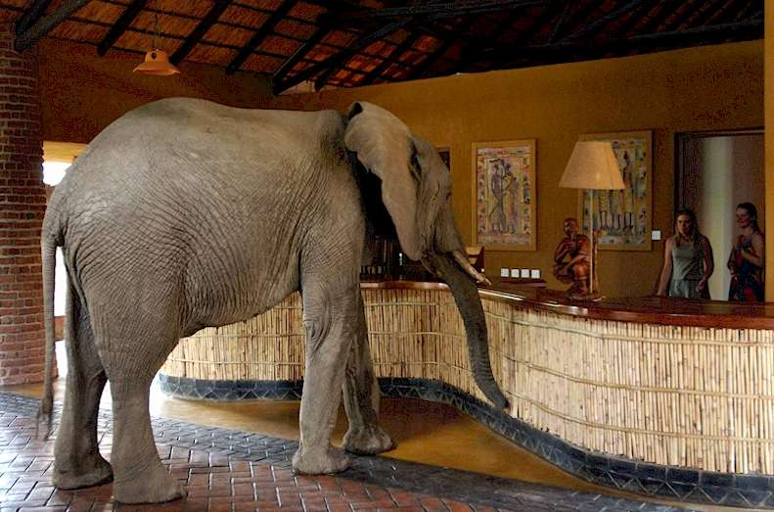
Ignoring the Elephant
Consciousness!
Why aren't we zombies?
What does consciousness do?
Why do organic robots have the causal/functional capacity to talk about sentience?

Slide 18

Case Study: Visual Intelligence vs Echolocatory Intelligence
What Is It Like To Be A Super-Intelligent Bat?
To understand the world - both its formal/mathematical and its subjective properties - sentient organic life must bootstrap our way to Full-Spectrum Superintelligence. We need to find ways to navigate all possible state-spaces of qualia and map them - initially via the neural correlates of consciousness - onto the formalism of mathematical physics.
What methodology can we use to investigate first-person states?

Slide 19

The Great Transition
“The mind is its own place and in itself, can make a Heaven of Hell, a Hell of Heaven.”
-John Milton
The Pleasure Principle
Is it (super)smart to be (super)happy?

Slide 20
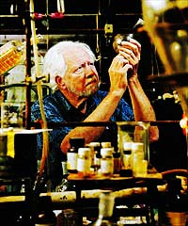
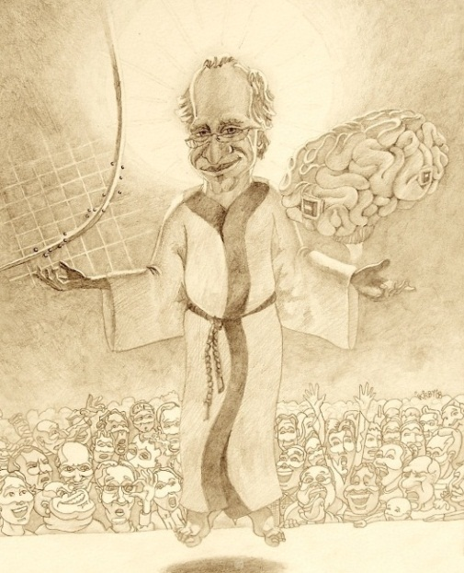
The Future of Sentience
Superlongevity?
Supersentience?
Superhappiness?
Superintelligence?
BioIntelligence-Explosion.com
The End

